Slide 1
Stick Chase
By, Alex Blair and Andrew McNeill

Slide 2
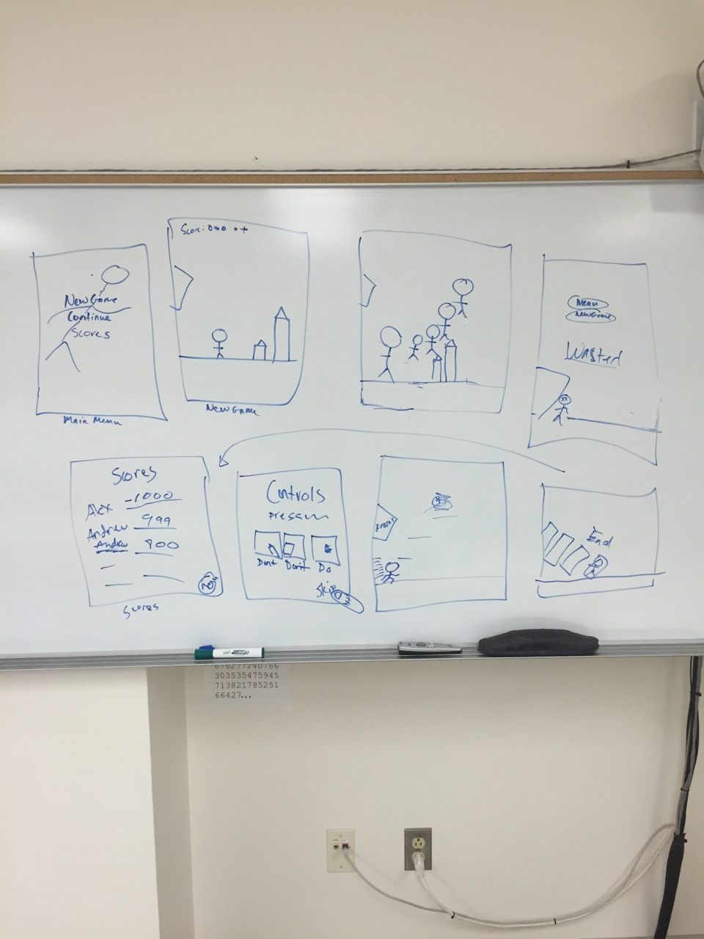
Idea
Let’s make a game!
Initial idea was a 2D side scrolling platform game.
Used Android Studio to program this game in Java.
Goal is to have this game available on the Google Play Store.

Slide 3
Development
First time programming in Java for both of us.
Used Github for Source Control.
With the help of the internet, our Professor Pete Tucker, and a few Youtube tutorials we have achieved a good base for future development of our game.

Slide 4
Challenges
Physics!!!!!!
Creating our first major program in Java when neither of us have used this language before.
Brainstorming and conceptualizing ideas, and figuring out how to put that into code.
Timeline

Slide 5
Group Contributions
At the beginning of this project the two of us worked pretty separately.
As the project progressed, we came together more and worked collaboratively to code and further the development process.
Alex: coding, organization, research
Andrew: Art, coding, organization, research

Slide 6
Future Development?
We would like to finish this game at some point before graduation.
We look to incorporate danger elements such as obstacles and spikes.
We also hope to add more mechanics to slow the user if they hit an obstacle and to add a chance of loss.
Also, we would like to add a score counter and a scores menu that can be accessed from the main menu.
Lastly, we hope to add power-ups abilities as well as the ability to stop the game and resume where left off.

